Slide 1
Religion in the Middle East
SWBAT: identify the major religions of the Middle East and the key components of each.

Slide 2
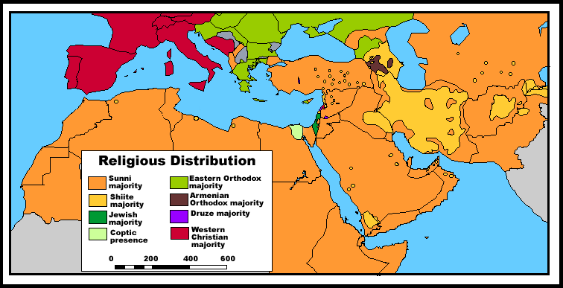
Birthplace of Monotheistic Religions
The Middle East is the birthplace of Monotheism or the believe in one god.
Three of the world’s leading monotheistic religions were formed here.
Judaism
Christianity
Islam

Slide 3
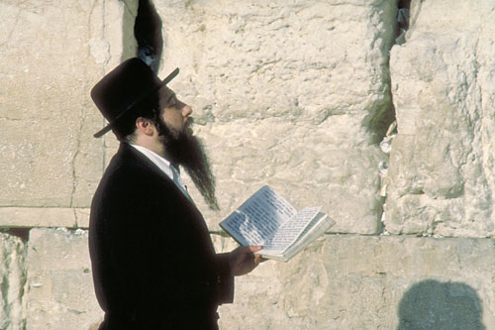
Judaism
Jews believe that god selected them to set an example of ethical behavior for the rest of the world. The rules and laws of Judaism are laid out in the Torah or the first five books of the Christians Old Testament. Abraham is seen as the founder of Judaism and he and his people were based in present day Israel. Overtime though, the Jews were forced out of their homeland in the Middle East in what is known as the Jewish Diaspora or the period in which Jews were “dispersed” or scattered over a wide area. The Jews maintained their religious and cultural practices while living in other countries, and in other cultures. They returned to the Middle East in the mid 1900’s.

Slide 4
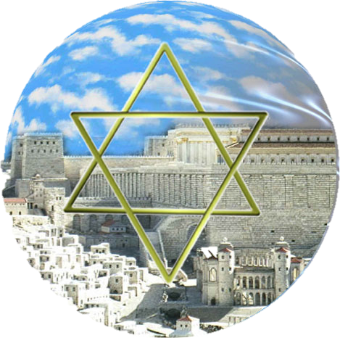
Take A Look at Jews Praying at the Western Wall
Information on the Western Wall
Webcam of the Western Wall

Slide 5
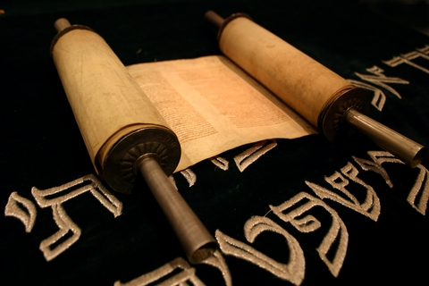
Basics of Judaism?
http://www.chiddingstone.kent.sch.uk/homework/religion/jewish.htm

Slide 6
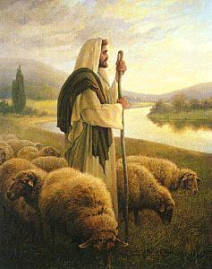
Christianity
Christianity was founded in Middle East by Jesus Christ a Jewish man.. Christians accept the Ten Commandments, established in Judaism, as ethic rules to live by. Christians utilize the Bible especially the New Testament which were written by the disciples or followers of Christ. Christianity has experienced rapid growth making it the world’s largest religion.

Slide 7
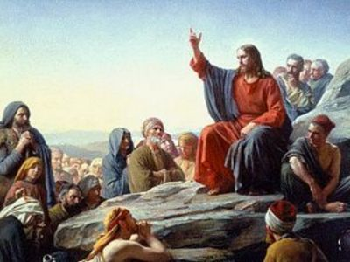
Christianity in Depth.

Slide 8
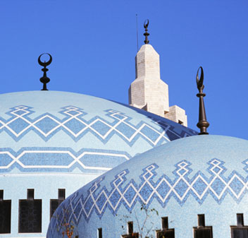
Islam
Followers of the Islamic religion are called Muslims. Like Jews and Christians, Muslims believe in one god and do not believe in rebirth. The Muslim god is known as Allah. Muslims study the teachings of Allah in a book of scripture known as the Koran. All Muslims learn the Five Pillars of Islam: faith, prayer, charity, fasting, and hajj. The hajj is a journey a Muslim makes to Mecca, their holiest city. Muslims believe their founder, Muhammed, saw a vision that told him to preach the teachings of Allah. Islam, like Christianity, has quickly spread out of the Middle East and become the world’s second largest religion behind Christianity.

Slide 9
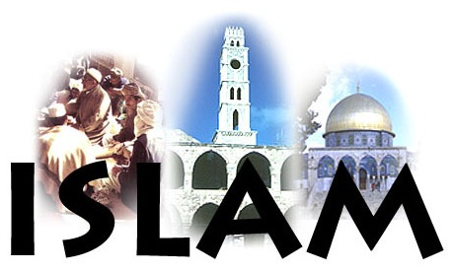
Islam in Depth.

Slide 10
A video of Islam.
http://www.5min.com/Video/What-Is-Islam-8278

Slide 11
Use your notes and your new knowledge to complete your own diagram that compares and contrasts the three religions.

Slide 12
Religions of the Middle East
Click here to play a game.

