Slide 1
Arab Spring #2

Slide 2
Egypt
Use this link to look at the timeline located on the right side of the page.
Investigate:
How did the Revolution Start?
How did the Government respond?
How did the Revolution End?

Slide 3
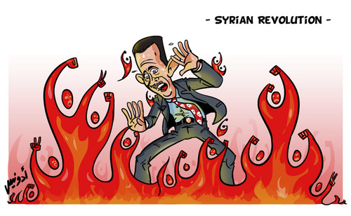
Syria
Syrians' Push for Power

Slide 4
Syria

Slide 6
What are we to do?

