Slide 1
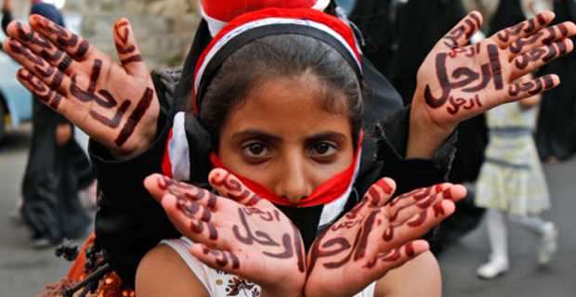
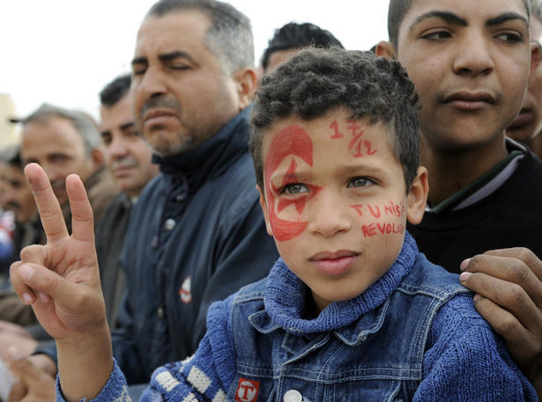
The People’s Push for Power
SWBAT reflect on and explain the importance of the Middle East’s push for people power in recent years. They will also investigate the different reactions of governments.

Slide 2
In December of 2010 a Tunisian man sat himself on fire in protest of his treatment by police. No one could have ever imagined the movement he created in an already unstable yet important region.

Slide 3
What is the Arab Spring?
The Arab Spring is a revolutionary wave of demonstrations that occurred in the Middle East that began on December 18, 2010. To date, there have been Revolutions in Tunisia and Egypt, a civil war in Libya, and uprisings continue in a number of other countries such as Syria.

Slide 4
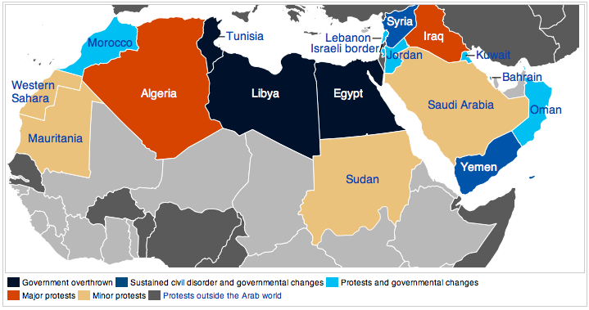

Slide 5
Causes of the Spring Spring
Totalitarian Leaders
Corruption
Human Rights Violations
Unemployment & Poverty

Slide 6
Goals of the Arab Spring
Democracy
Regain Human Rights
Free and FAIR elections
Regime Change

Slide 7
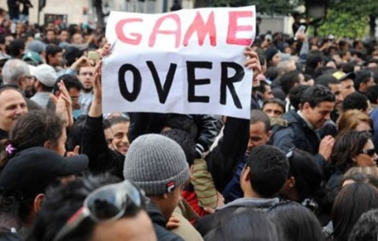
Tunisia
http://www.aljazeera.com/news/africa/2011/05/201158141454599904.html

Slide 8
